Slide 1
Weka Data mining in docking and h-bond interaction results
Decoys of NS5B Palm2 Binding Site

Slide 2
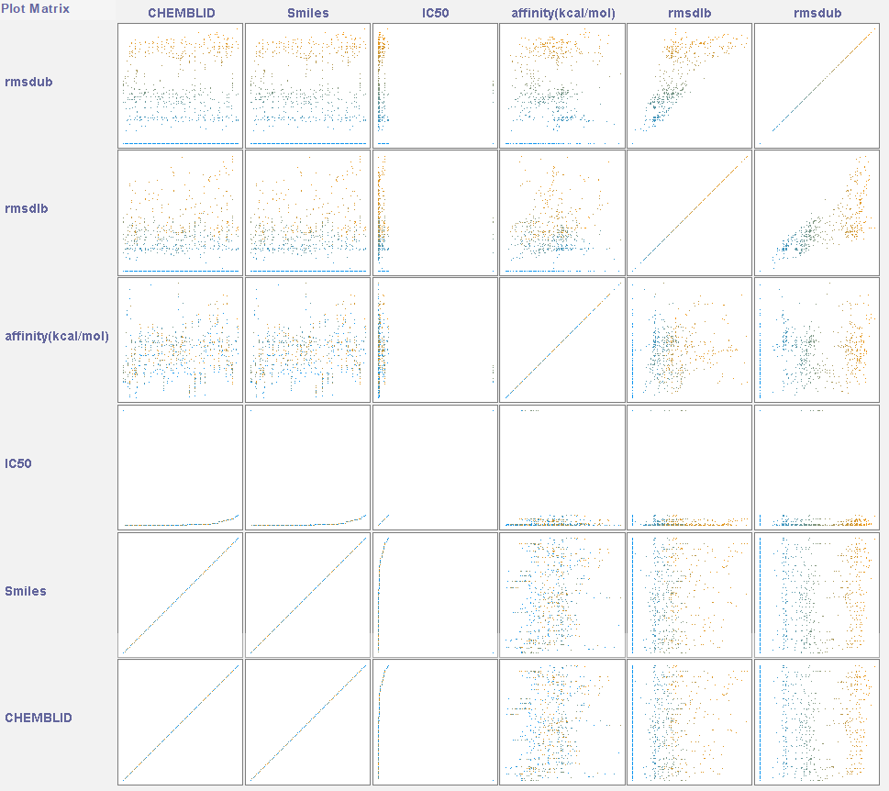

PDB id:3fqk Docking score

Slide 3
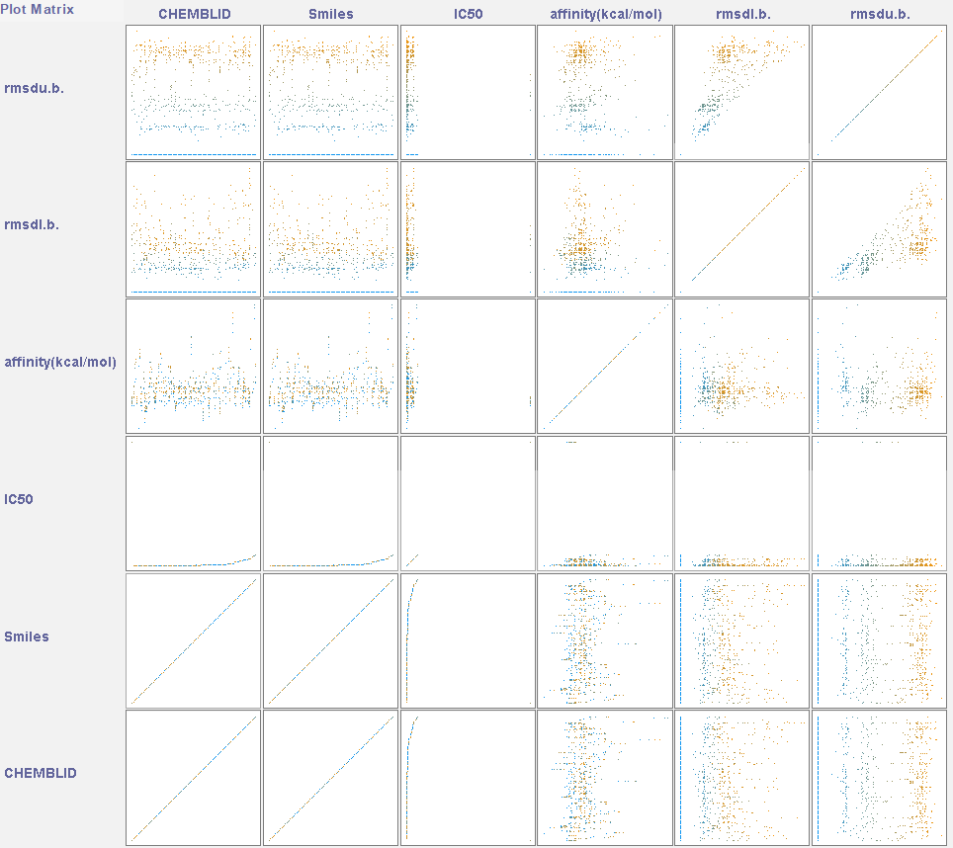

PDB id:3fql Docking score

Slide 4
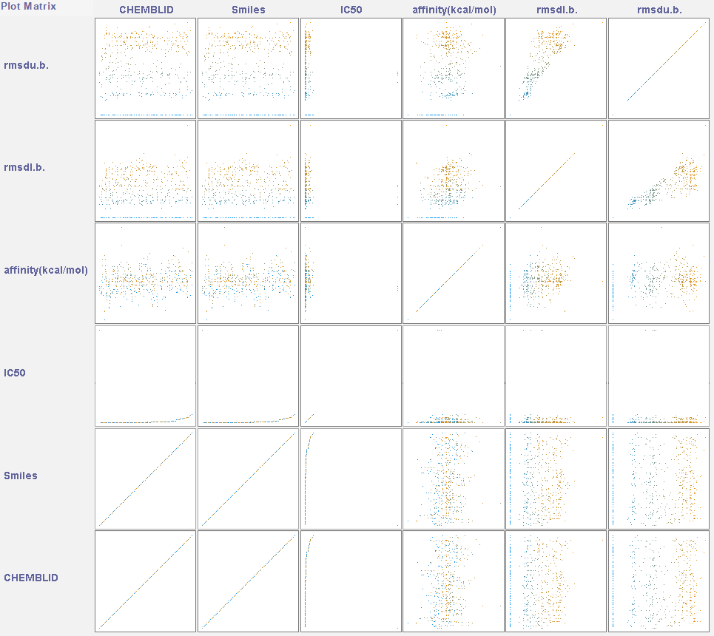

PDB id:4kai Docking score

Slide 5
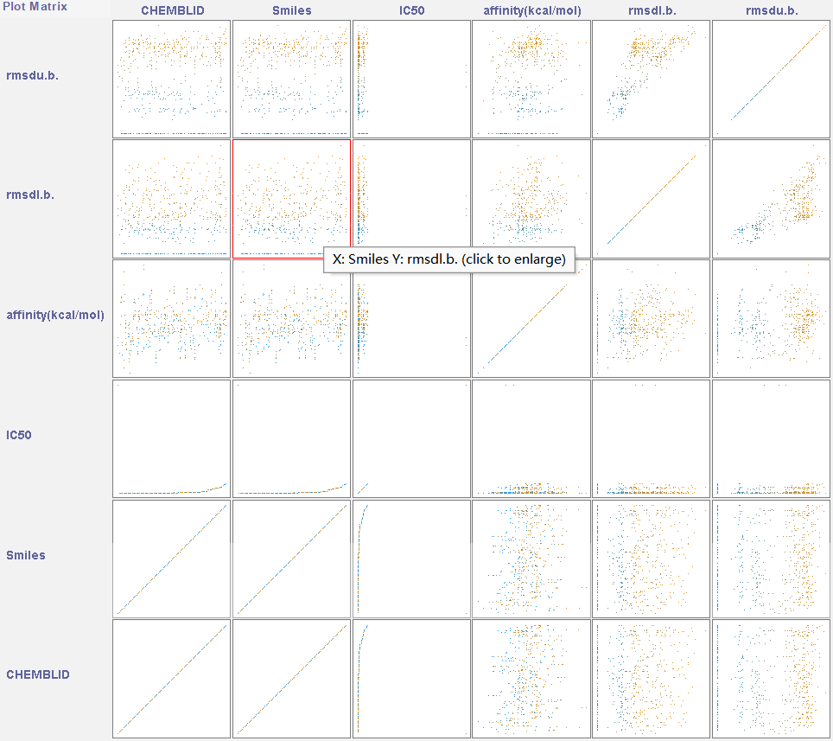

PDB id:4ke5 Docking score

Slide 6
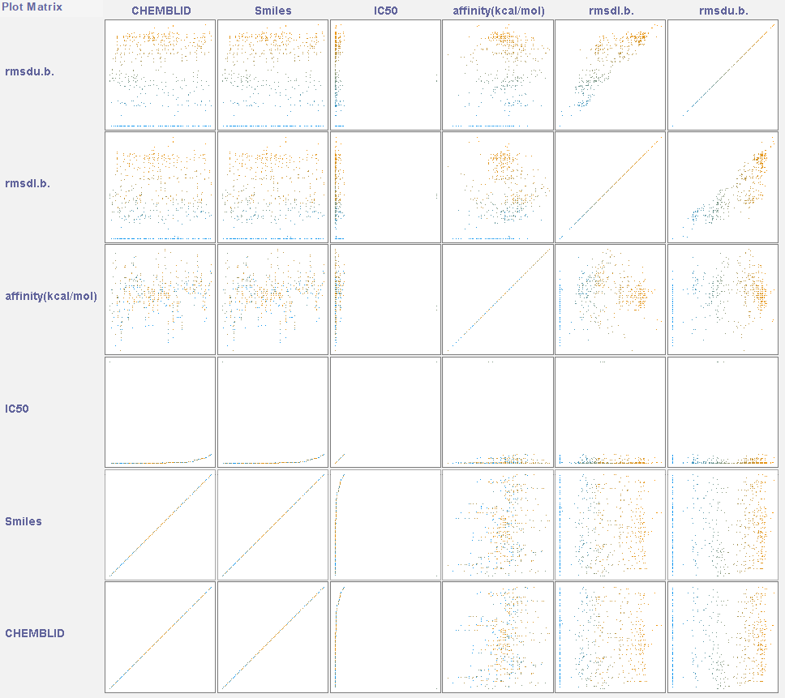

PDB id:4khm Docking score

Slide 7
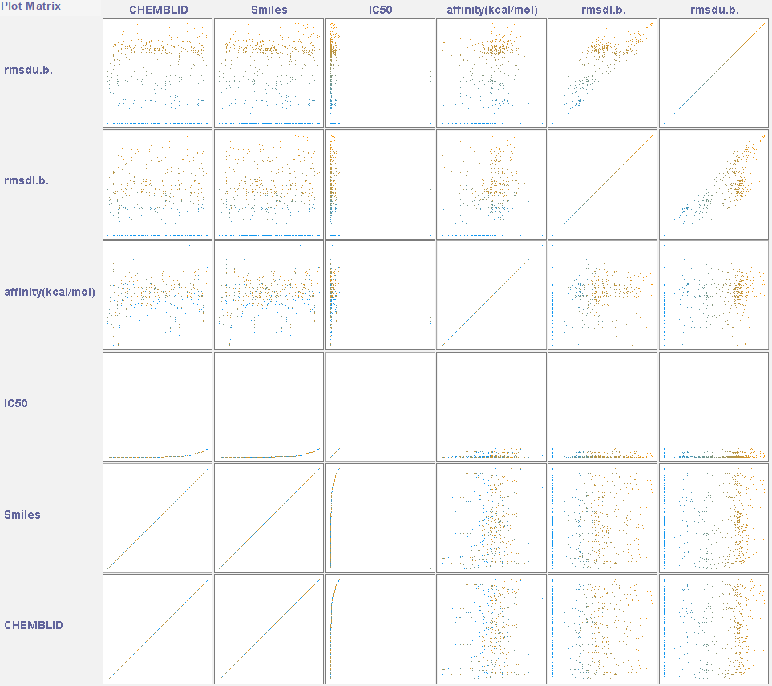

PDB id:4khr Docking score

Slide 8
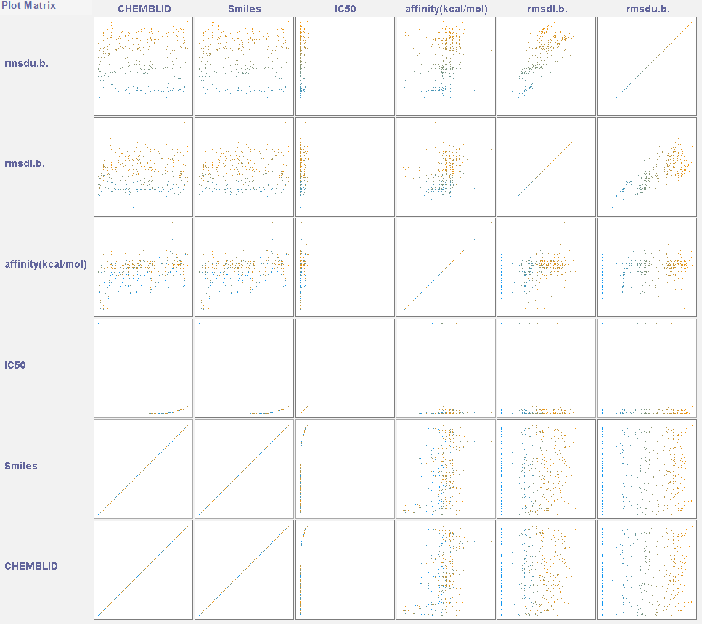

PDB id:5trh Docking score

Slide 9
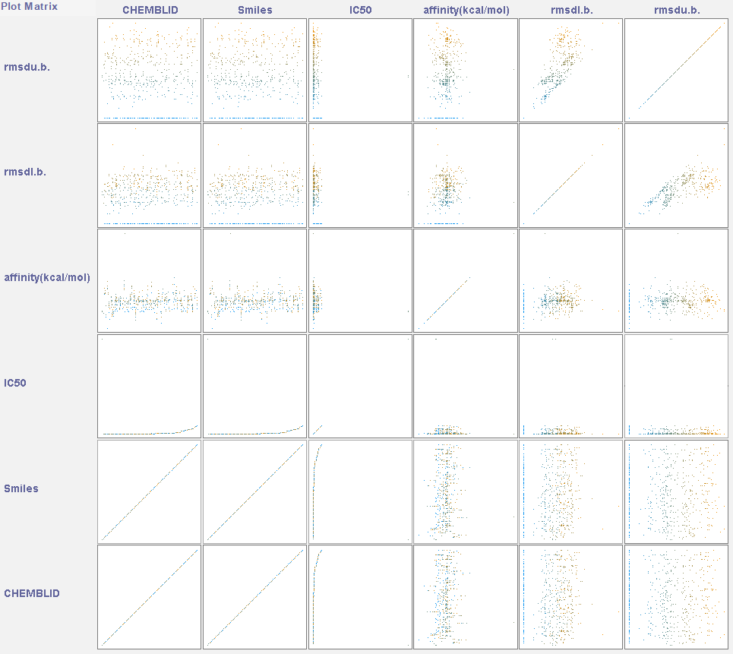

PDB id:5w2e Docking score

Slide 10
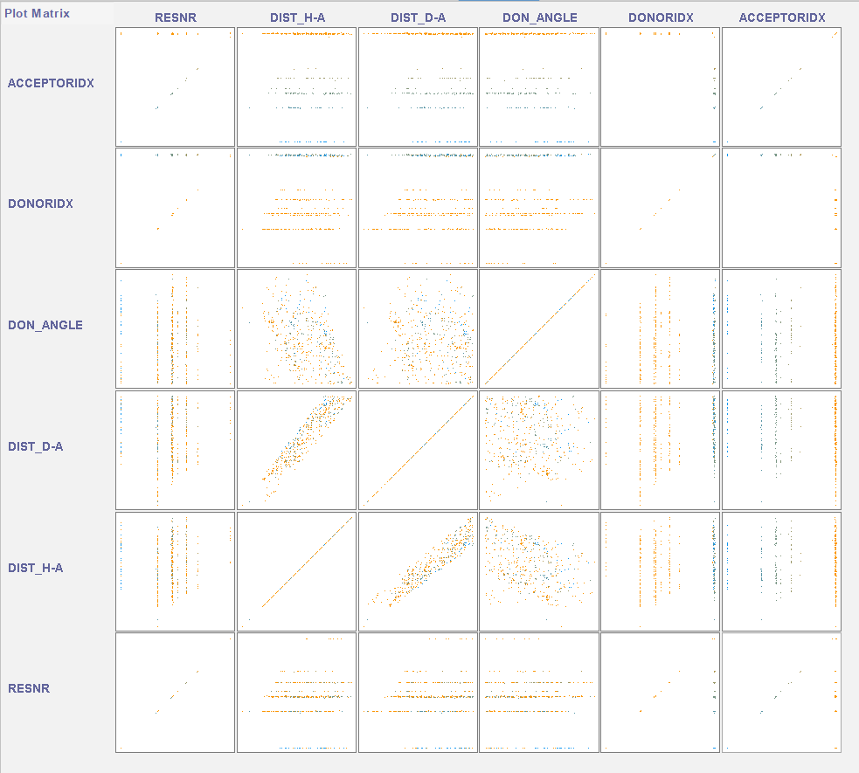
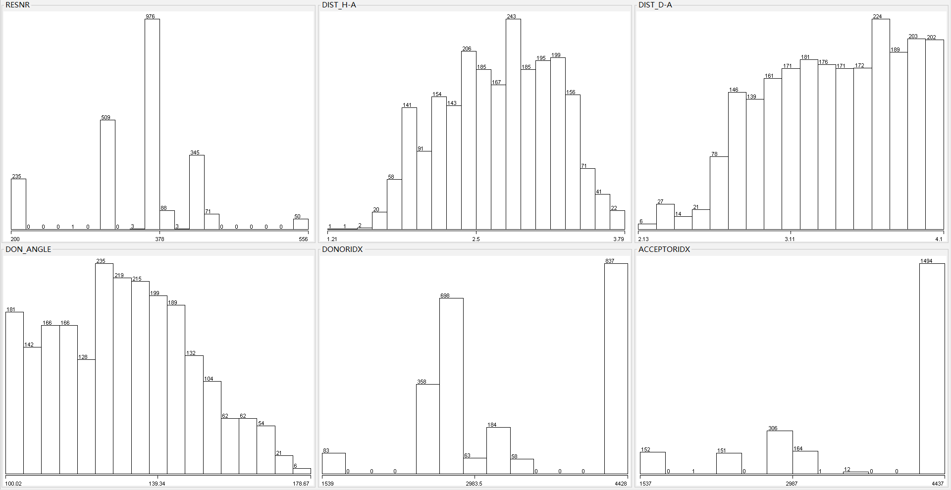
PDB id:3fqk h-bond
counts
values

Slide 11
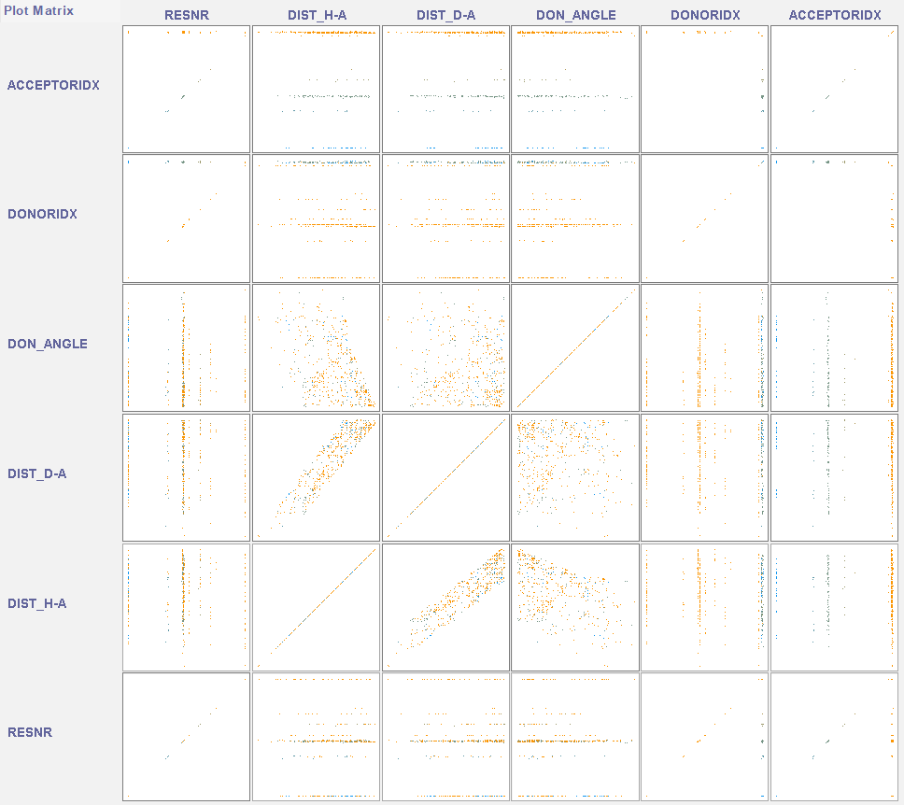
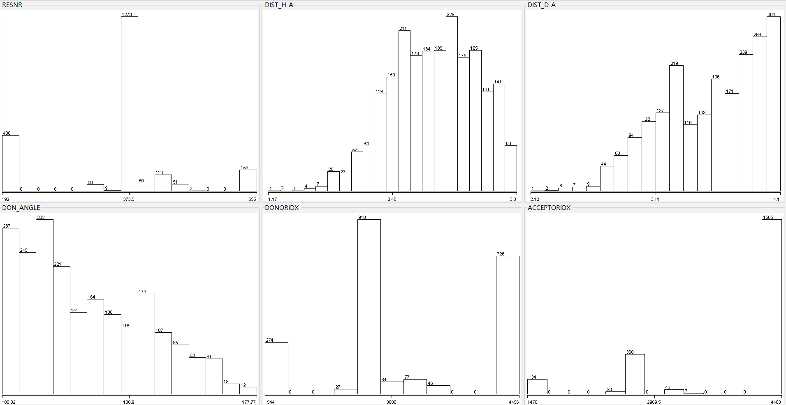
PDB id:3fqL h-bond

Slide 12
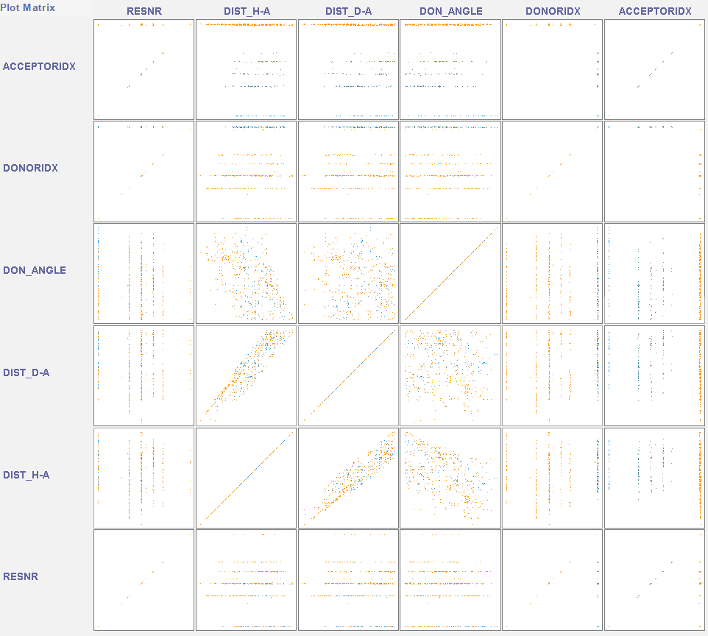
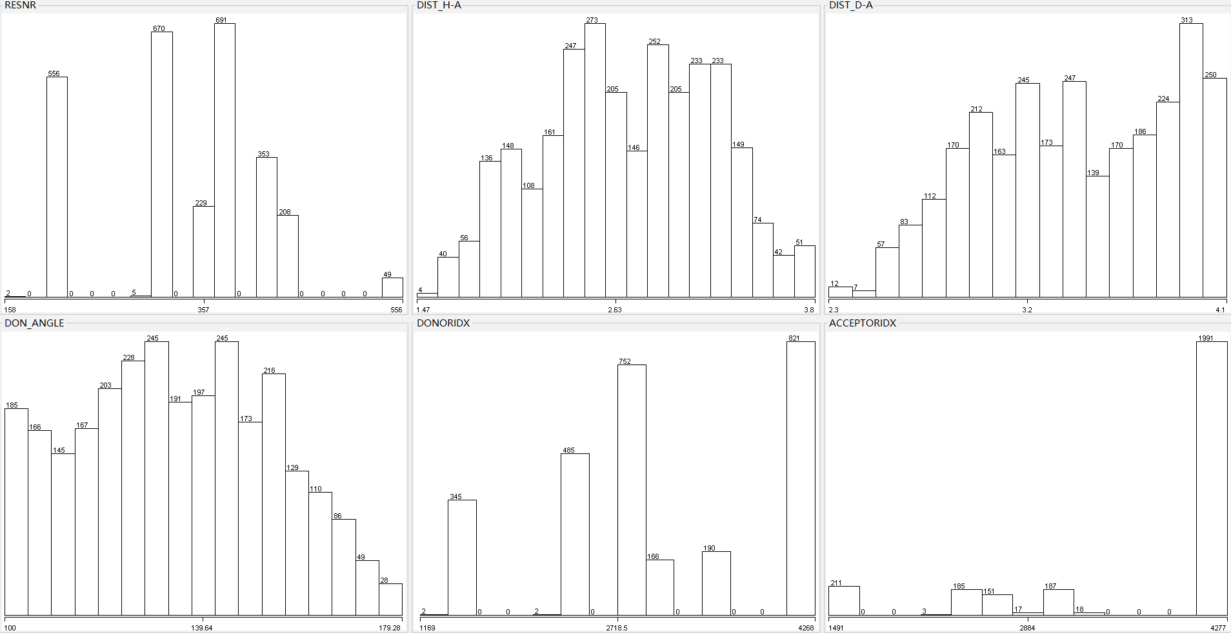
PDB id:4kai h-bond

Slide 13
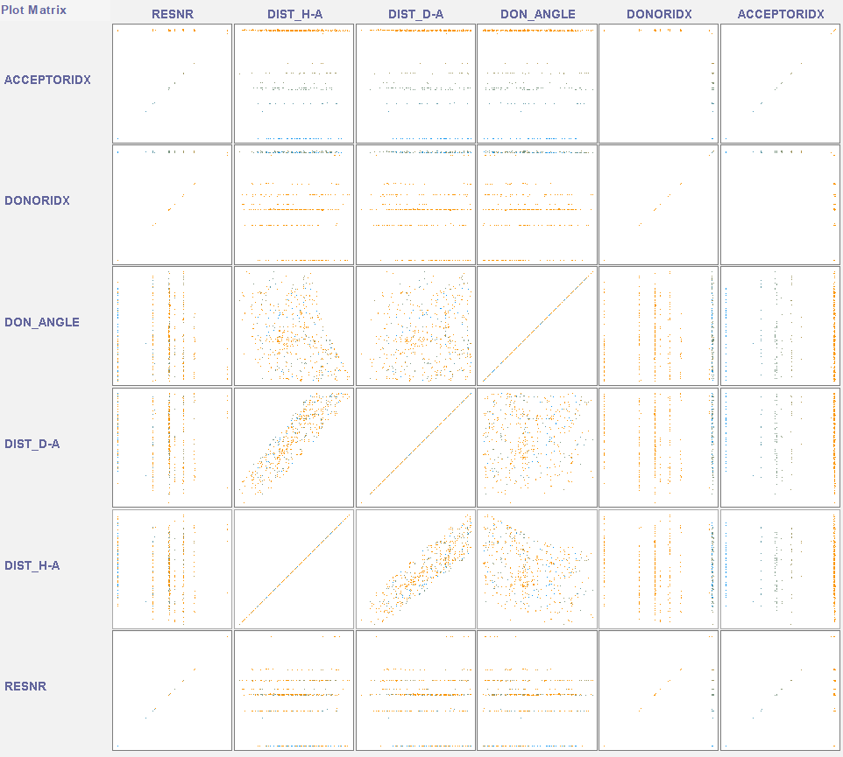
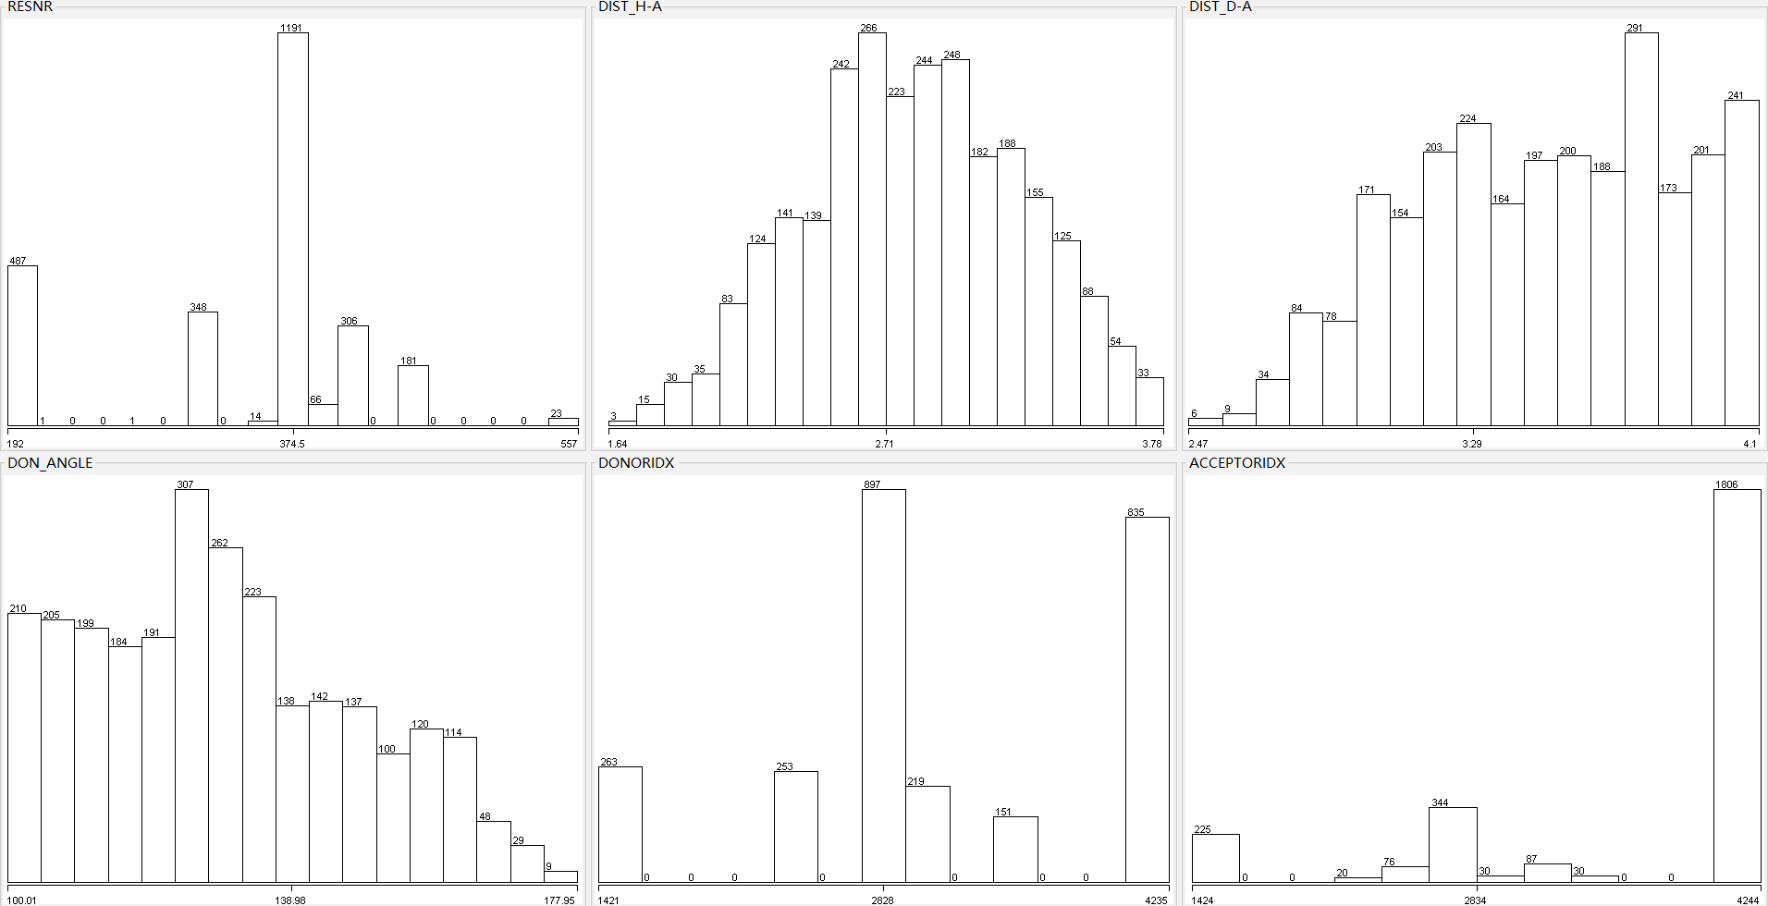
PDB id:4ke5 h-bond

Slide 14
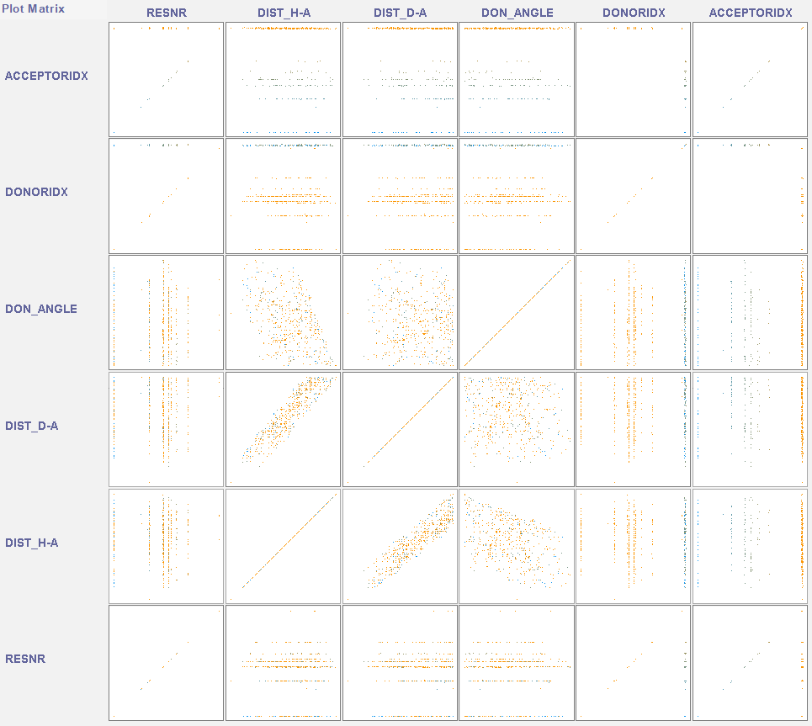
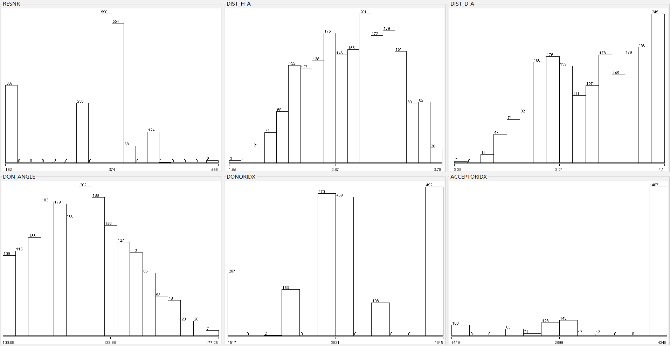
PDB id:4khr h-bond

Slide 15
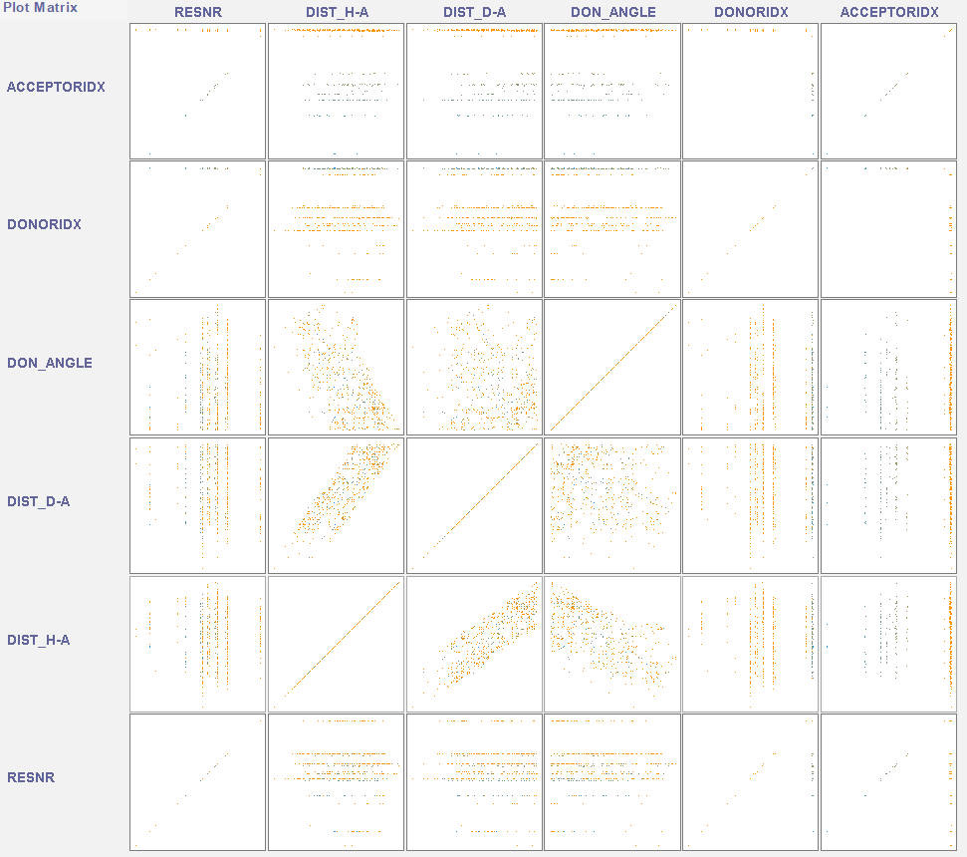
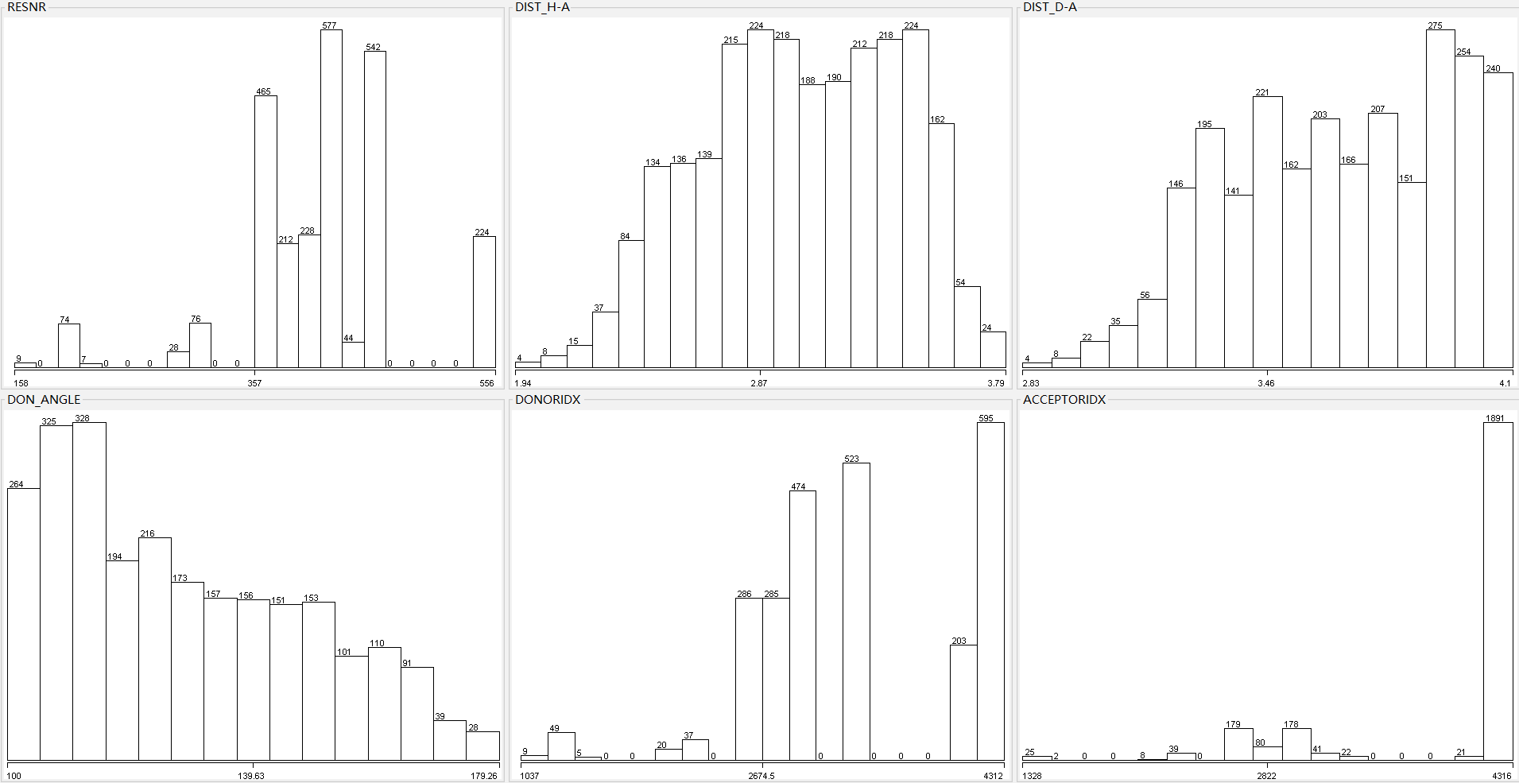
PDB id:5trh h-bond

Slide 16
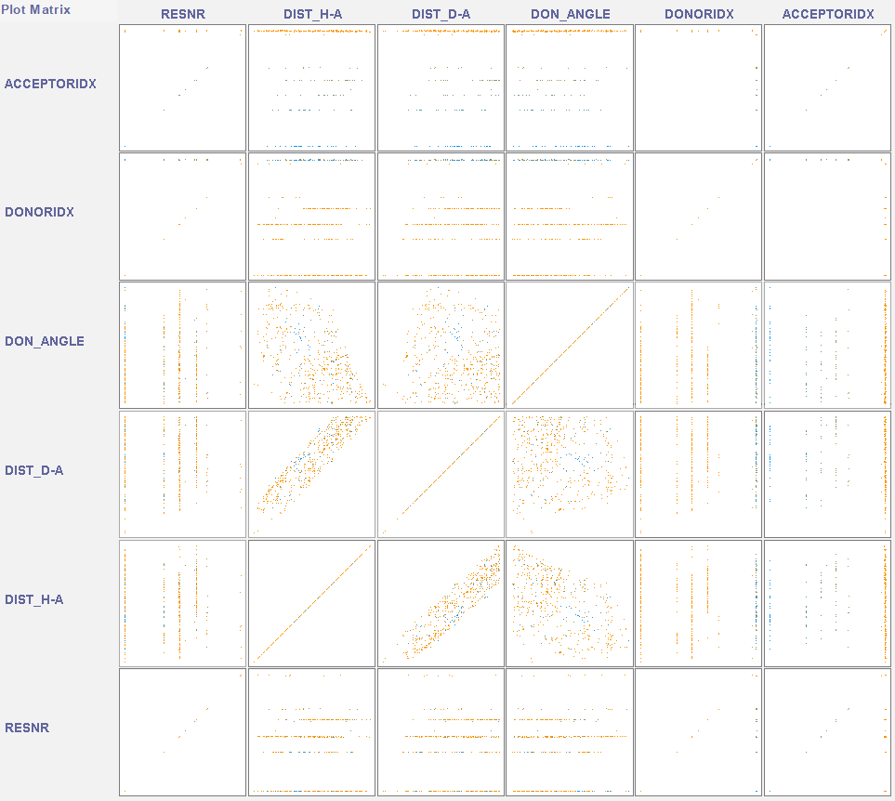
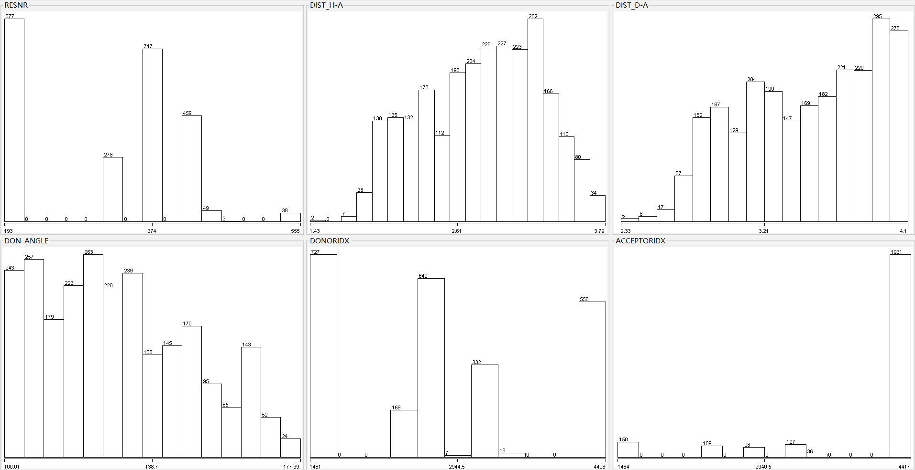
PDB id:5W2e h-bond

